Slide 1

Keystroke Logging
Mridul Singh Rajput

Slide 2

PROBLEM STATEMENT
Pervasive Monitoring: Keyloggers capture every single
keystroke made on a device, leaving no typed data private.
Data Vulnerability: High-risk information like passwords and financial details are easily stolen by malicious actors.
Dual-Use Dilemma: Legitimate monitoring needs must be balanced against the severe risk of anonymity and encryption breaches.
Lack of Validation: There is a critical requirement for better testing and validation to ensure these tools are only used for their intended, legitimate purposes.

Slide 3
Project Description
Keystroke Monitoring & Analysis: Implementing systems that capture and record input data for specialized monitoring purposes.
Security & Data Privacy: Developing end-to-end encryption and anonymity features to protect captured information from external threats.
Vulnerability Mitigation: Engineering proactive protection mechanisms and security enhancements to defend against the malicious exploitation of keyloggers.
Compliance & Validation: Ensuring all system functionalities align with legal standards through dedicated research and continuous system validation.

Slide 4

WHO ARE THE END USERS?
The end users of keylogging technology are divided into protectors, such as IT admins and parents, who use it for data recovery and child safety.
Security professionals also utilize it for legal investigations and developing defensive software to counter cyber threats.
Conversely, malicious actors exploit the tool as a digital weapon to steal sensitive financial information and personal credentials.

Slide 5

Technology Used
Keyboard Monitoring: The project utilizes high-level Python libraries like pynput or keyboard to create a "listener" that runs in the background and records every keystroke event by interacting directly with the Operating System.
Data Storage & Logic: Python's built-in logging and threading modules allow the program to record data silently in the background without freezing the computer or alerting the user through a visible window.
Secure Exfiltration: The system uses modules such as smtplib to automatically bundle the recorded keystroke logs and secretly email them to the administrator's inbox at set time intervals.

Slide 6
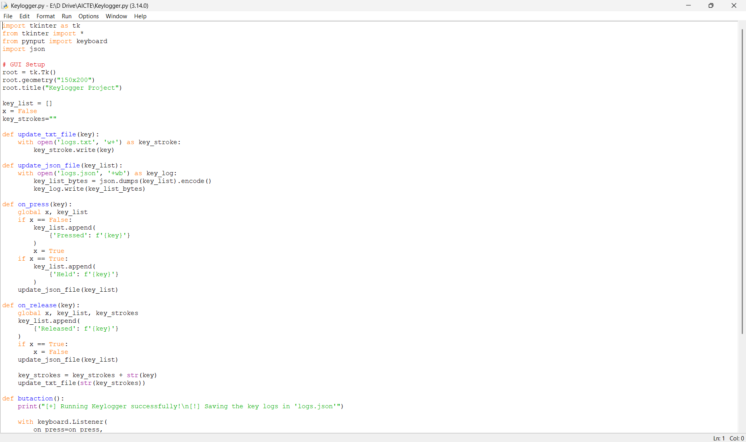
RESULTS

Slide 7
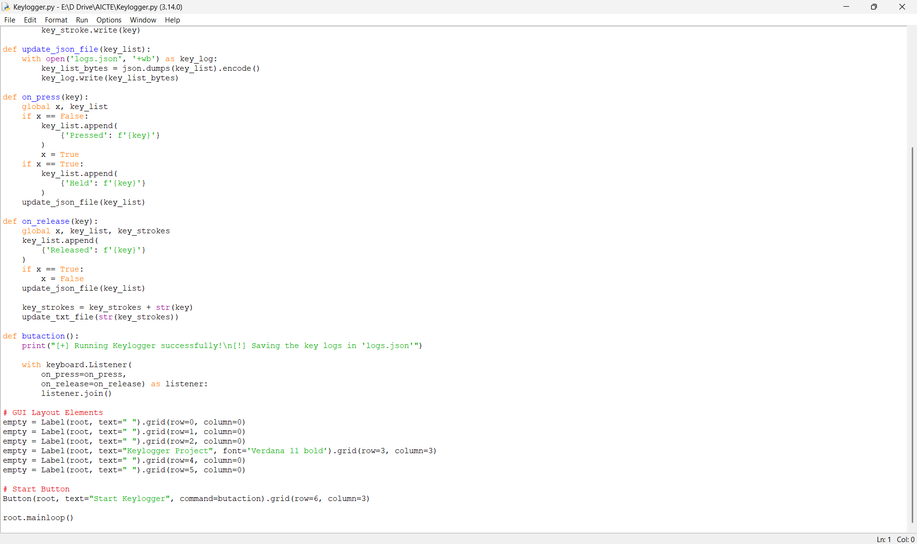
RESULTS
Demo Link

Slide 8
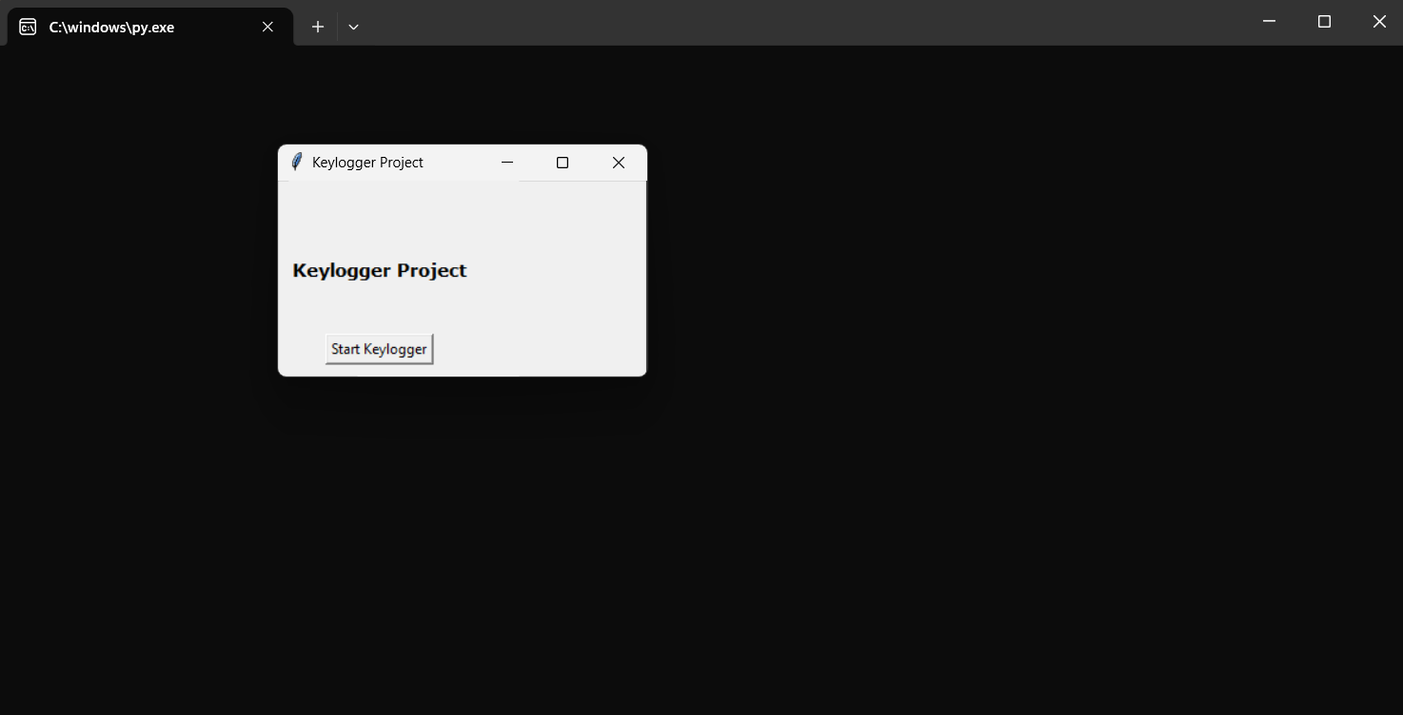
RESULTS
[Add screen shots of your code ]

Slide 9
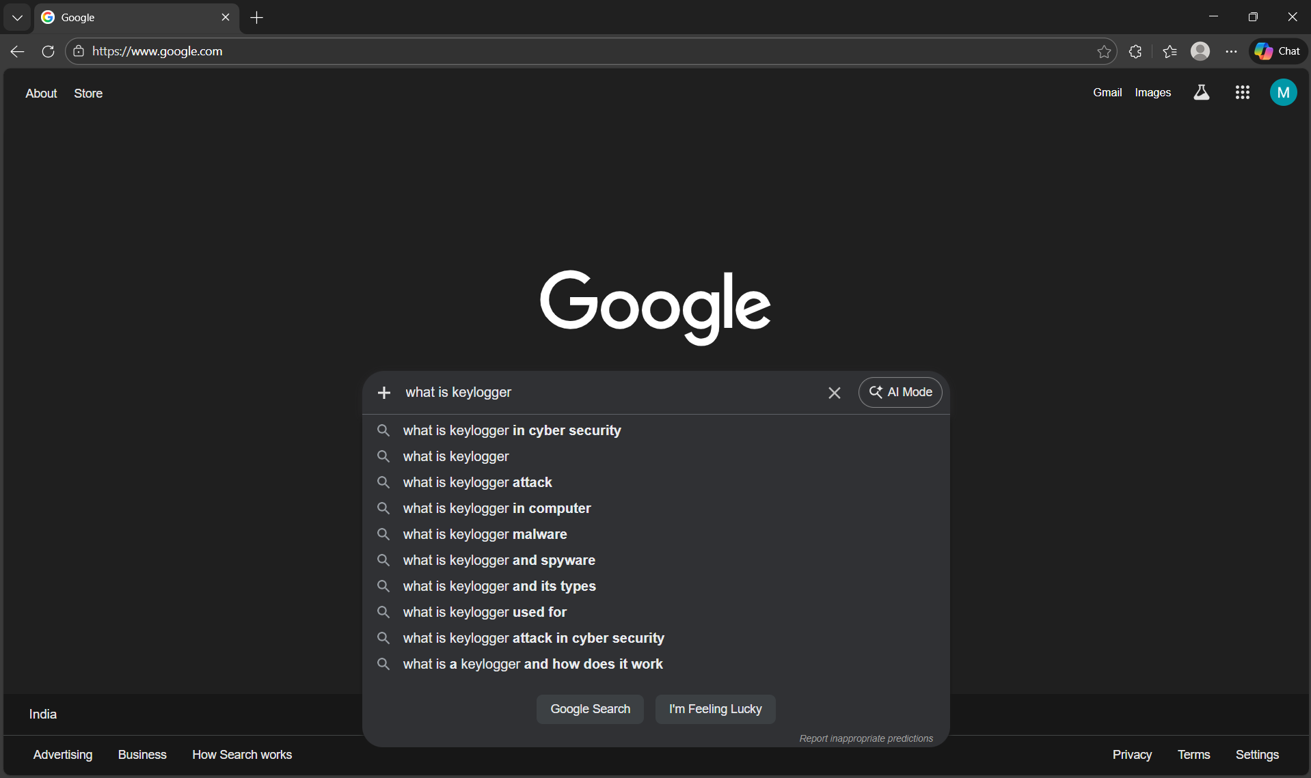
RESULTS
[Add screen shots of your code ]

Slide 10
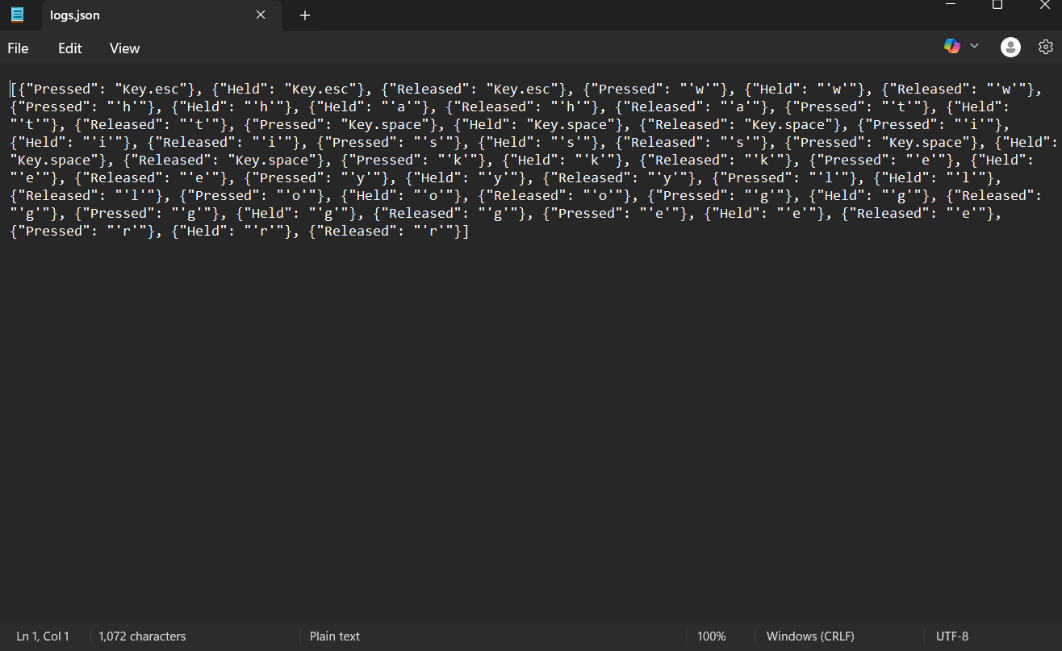
RESULTS
[Add screen shots of your code ]
Demo Link

Slide 11
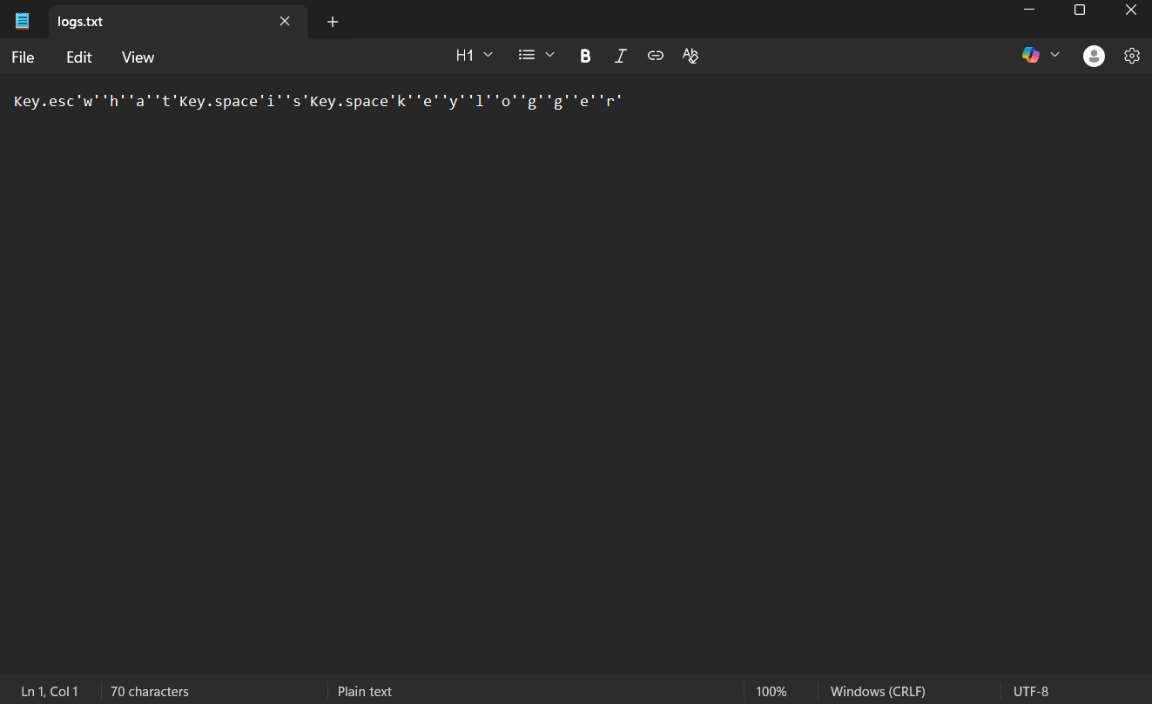
RESULTS
[Add screen shots of your code ]
Demo Link

Slide 12
Thank you

